Slide 1

ULINKERS
FINAL PRESENTATION
Teh Kaixin
Nicole Goh
Sean Kwok
Nabilah Banu
Chien Shu Yan

Slide 2
AGENDA
Introduction
Problem & Solution
Technologies
User Testing
Project Management
X-Factor
Reflections

Slide 3

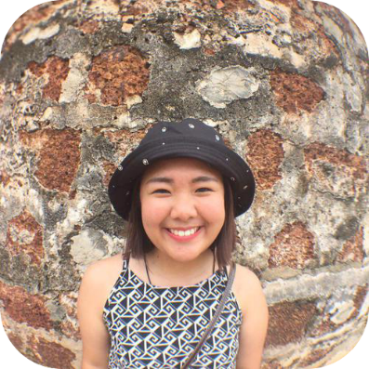
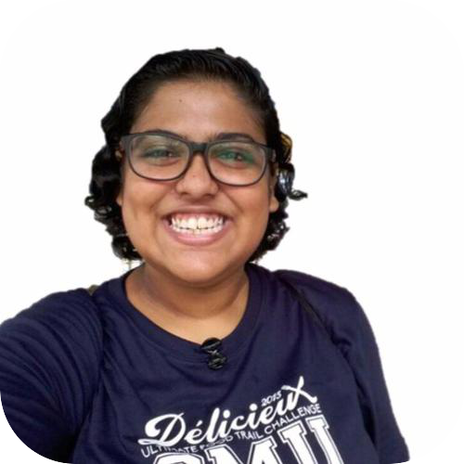
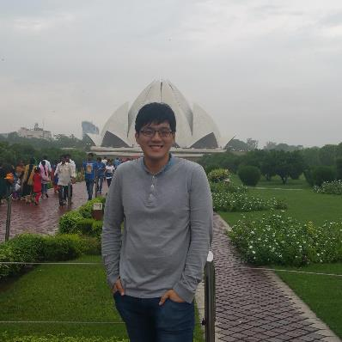
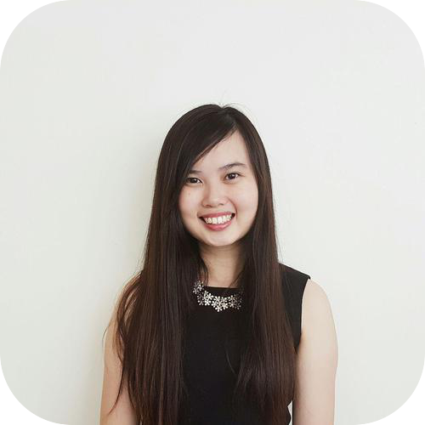
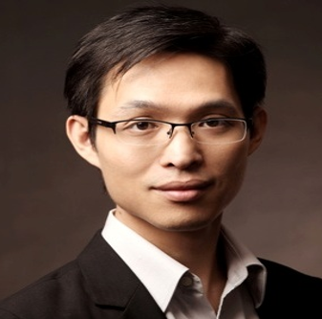
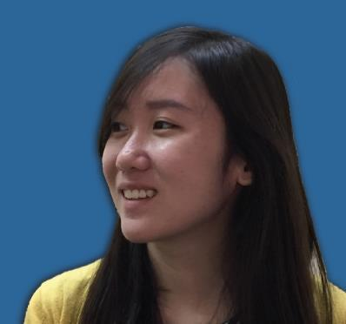
TEAM MEMBERS
Teh Kaixin
Nicole Goh
Project Manager
Deputy Quality Assurance
Lead Frontend Developer
Deputy Project Manager
Nabilah Banu
Business Analyst
Deputy Frontend Developer
Sean Kwok
Chien Shu Yan
Lead Backend Developer
Lead Quality Assurance
Professor Steven Hoi
Linda Siow
Supervisor
Sponsor

Slide 4





SPONSOR
Clients
Medical Concierge Provider
Clinic & hospitalisation arrangements
Treatment plans & price estimates
Travel arrangements & visas
Standby assistance in Singapore
Indonesia
Malaysia
Cambodia
Vietnam
Myanmar
China
Operating since 1996
15 Employees

Slide 5

PROBLEM

Slide 6
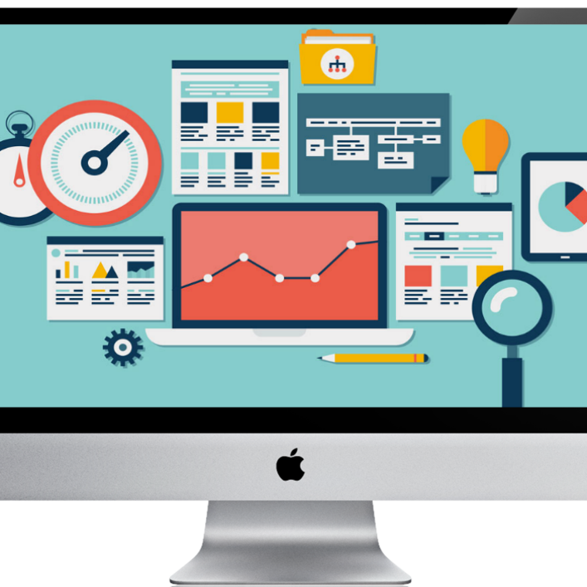
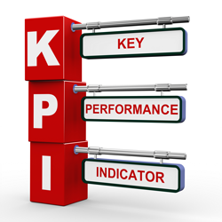

PROBLEM
No platform for ULINK to recommend screenings to clients
Difficult to keep track of teams’ performance
Difficult to determine engagements with stakeholders

Slide 7
PROBLEM
Majority of clients visit Ulink for one-off services
Ulink wishes to be more active in maintaining customer relationships
Zoho lacks functionality to recommend screenings based on clients’ demographics
No platform for ULINK to recommend screenings to clients

Slide 8
PROBLEM
2 Main teams: Medical and Visa
ZOHO CRM lacks the feature to provide cross-team performance comparisons
No proper record of teams’ performances
Unable to efficiently allocate resources
Difficult to keep track of teams’ performance

Slide 9
PROBLEM
Difficult to prioritize stakeholders
- Eg. Doctors, Referrals
Lack of basic information of clients
Importance of contact information for active engagement
Unable to maximize marketing effort
Difficult to determine engagements with stakeholders

Slide 10
SOLUTION

Slide 11




SOLUTION
Reporting tools for decision making
Screenings recommendation & Reminder
Client profile
Dashboard displays statistics & overview

Slide 12




SOLUTION
COMPARISON
Recommended screening based on demographic
Dashboard Reporting (Key performance metrics)
Monitor Departments’ Performance
Ranking (Stakeholder engagements)
Client Profile (Consolidated profile view of each client)
Email function To Recommend Screenings
Generate Reports with specified filters & Comparison

Slide 13
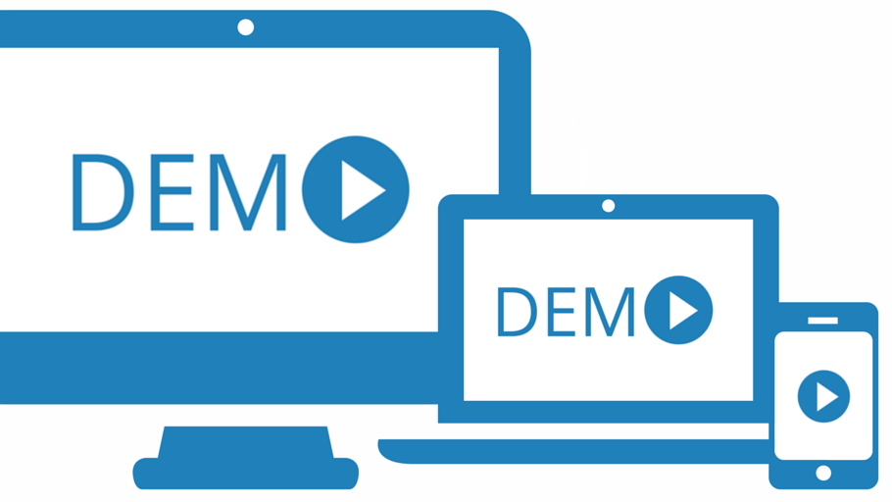

Slide 14
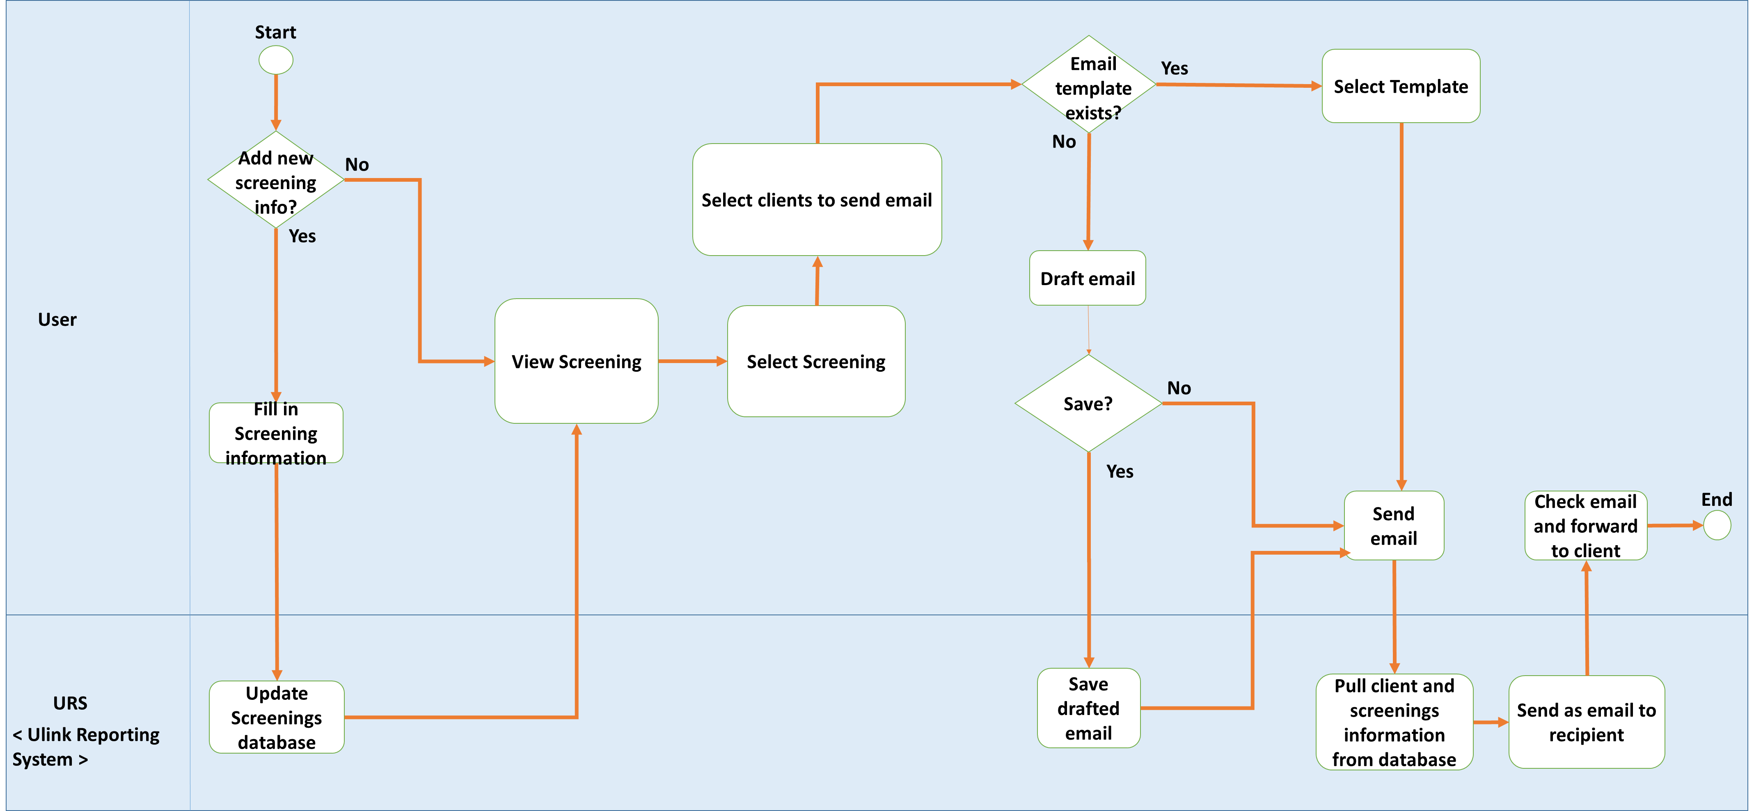
TO-BE WORKFLOW
Screenings and Email

Slide 15
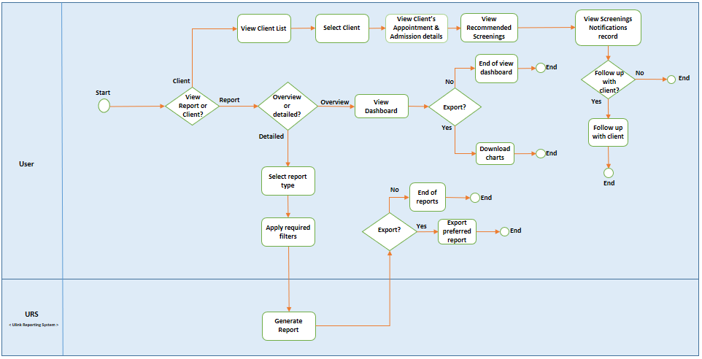
TO-BE WORKFLOW
Client, Dashboard and Reports

Slide 16

TECHNOLOGY
ARCHITECTURE DIAGRAM
TECHNICAL COMPLEXITY

Slide 17












TECHNOLOGY
ARCHITECTURE DIAGRAM
FRONTEND
BACKEND
OTHER SERVICES
HTTP GET POST JSON
JSON OUTPUT

Slide 18
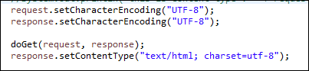
TECHNOLOGY
ARCHITECTURE DIAGRAM
PROBLEM:
Default Encoding value for getParameter - ISO-8859-1
Unable to read UTF-8 encoding value
01
SOLUTION:
Change database storing format and encoding value for getParameter
ENCODING CHARACTER

Slide 19
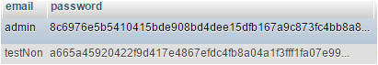
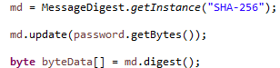
TECHNOLOGY
ARCHITECTURE DIAGRAM
02
PROBLEM:
To prevent client information being compromised
SOLUTION:
Encrypt password using SHA-256
SECURITY

Slide 20
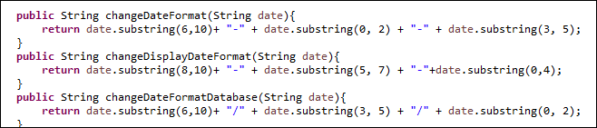
TECHNOLOGY
ARCHITECTURE DIAGRAM
03
PROBLEM:
Many different types of date formats required
SOLUTION:
Joda Time library & calendar from Java
DIFFERENT DATE FORMATS

Slide 21
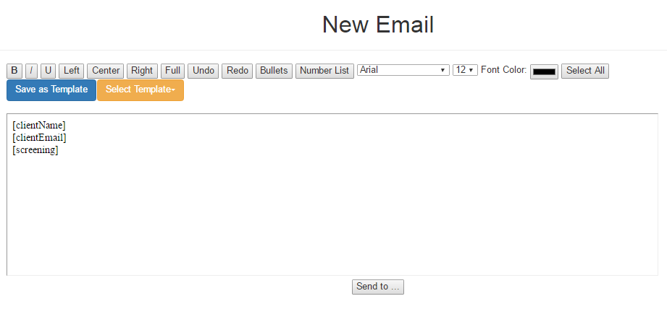
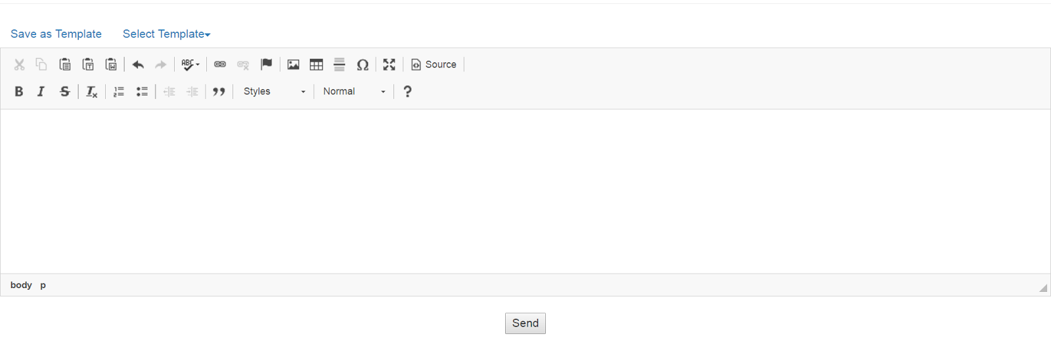
TECHNOLOGY
ARCHITECTURE DIAGRAM
PROBLEM:
Edit mode not user-friendly
Cannot save pasted text directly
Looks “Raw”
04
SOLUTION:
TEXT EDITOR (iFRAME)

Slide 22
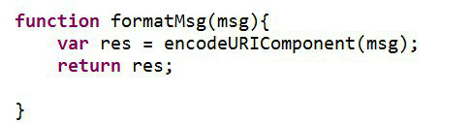
TECHNOLOGY
ARCHITECTURE DIAGRAM
PROBLEM:
Need to replace symbols to preserve original format
05
SOLUTION:
EncodeURIComponent
SAVING EMAIL TEMPLATE IN HTML FORMAT

Slide 23
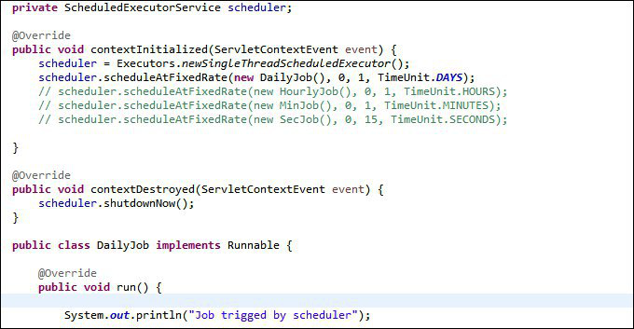
TECHNOLOGY
ARCHITECTURE DIAGRAM
PROBLEM:
Fetching live data from database daily
06
SOLUTION:
Create a scheduler that fetches the data from database daily
FETCHING LIVE DATA FROM ZOHO DATABASE

Slide 24

QUALITY ASSURANCE
INTERNAL TESTING
USER TESTING

Slide 25

QUALITY ASSURANCE
USER TESTING 1
PURPOSE
DETAILS
SCOPE
Easy to navigate
Participant: Linda (Sponsor)
Date: 28 October 2016
Time: 4.00pm
Venue: Ulink Assist Pte Ltd
Client Creation Module
Timeline Module
Reports Module
KPI
Ranking
Gender - Age Report
Gather UI feedback & detect usability issues
Timeline for screenings design is not intuitive
Naming of columns and fields are confusing

Slide 26

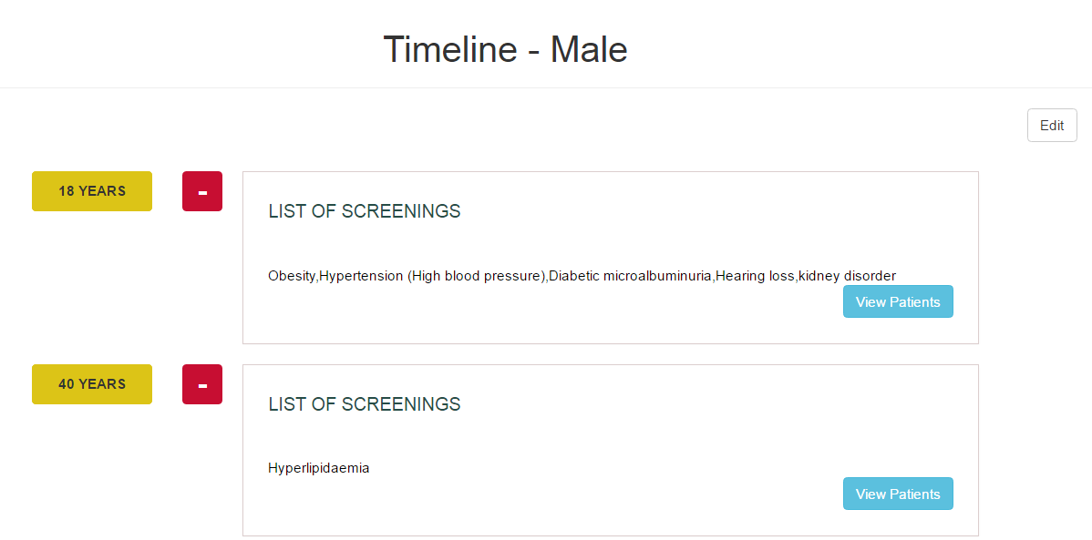
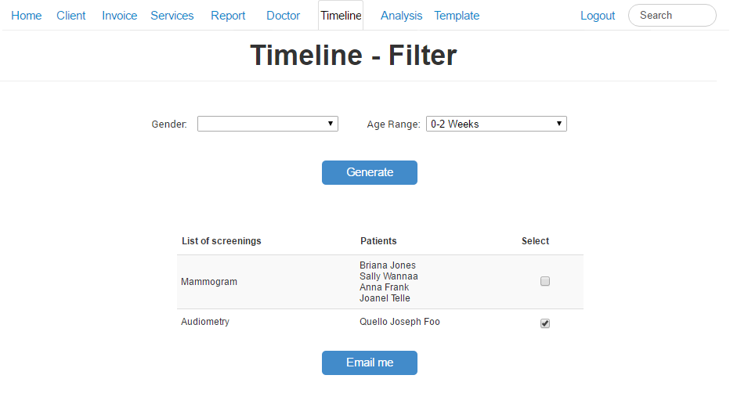

QUALITY ASSURANCE
USER TESTING 1
FEEDBACK:
Timeline display is not intuitive, user suggested to change to table format
Stick to one color scheme
Client prefers to choose which patient to send email to instead of automated sending of email

Slide 27
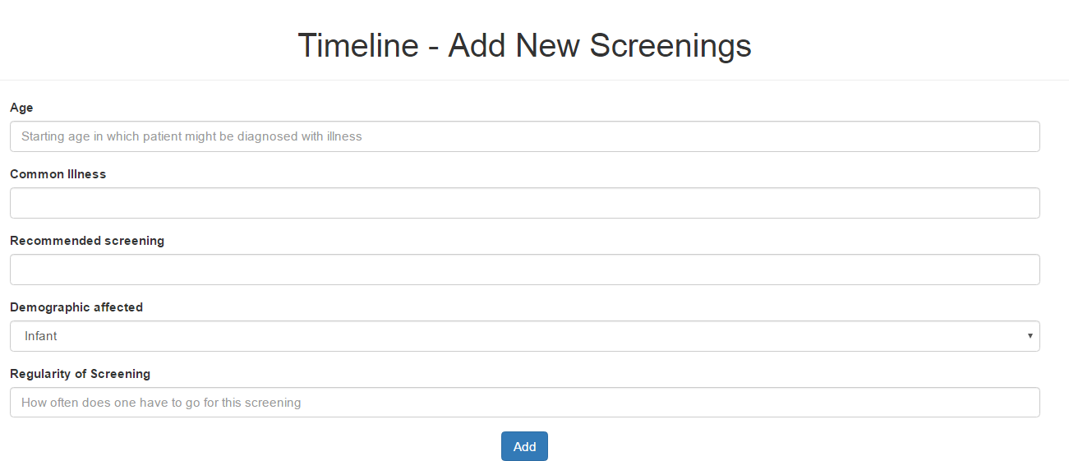
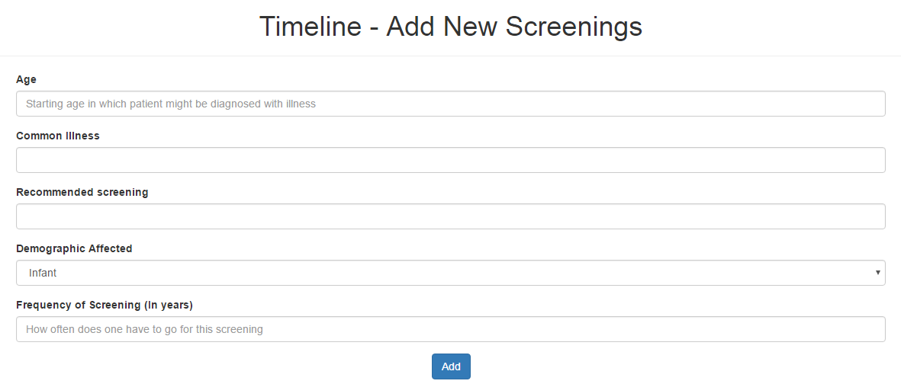
QUALITY ASSURANCE
USER TESTING 1
FEEDBACK:
Rename Regularity field to Frequency of Screening (In Years) for easy understanding

Slide 28
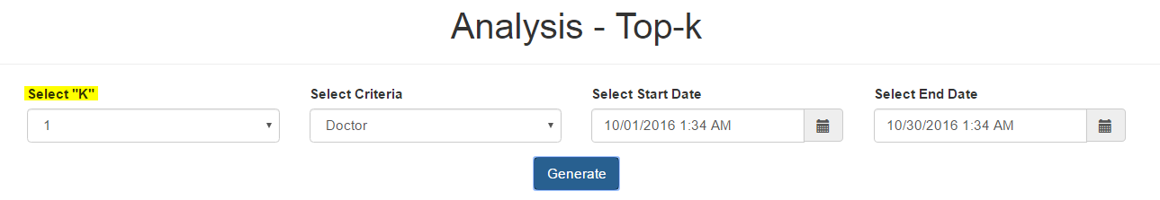

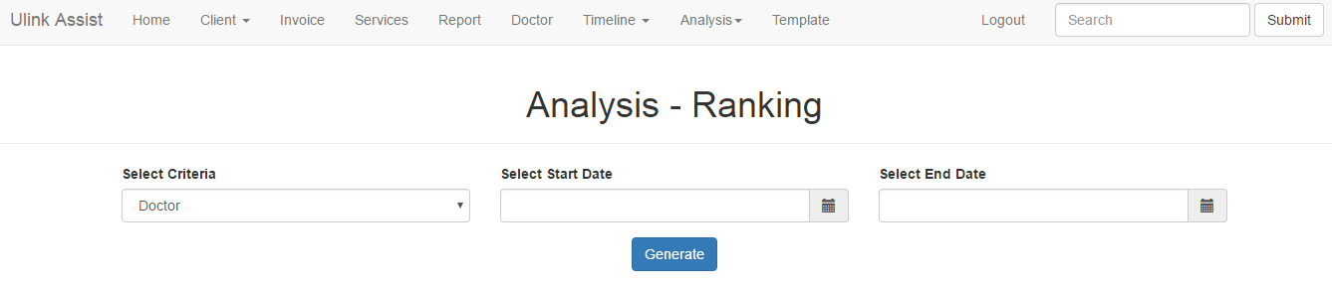
QUALITY ASSURANCE
USER TESTING 1
FEEDBACK:
Top-K function to rename as "Ranking" for easy understanding
List all results in a ranked list instead of selecting “K” value

Slide 29
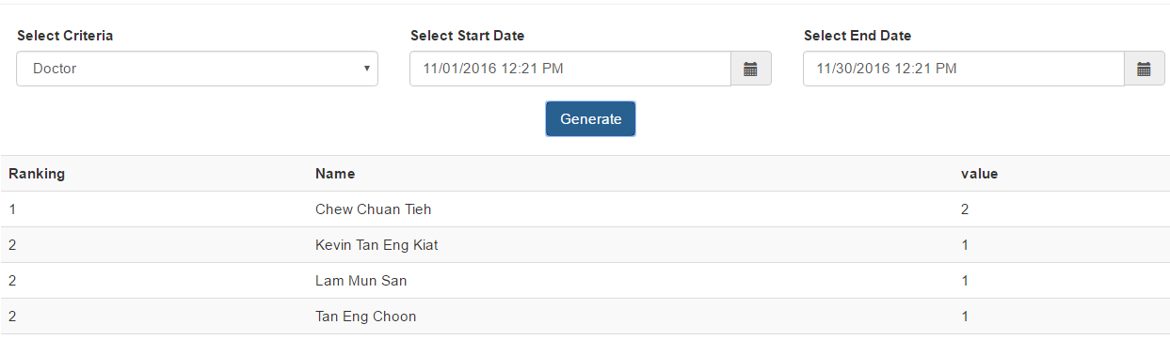
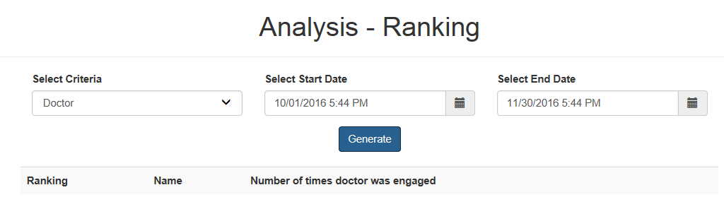
QUALITY ASSURANCE
USER TESTING 1
FEEDBACK:
Confusing naming

Slide 30
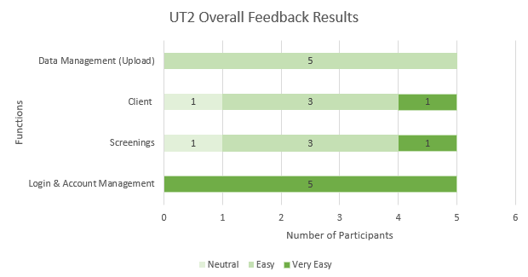
QUALITY ASSURANCE
USER TESTING 2
PURPOSE
DETAILS
SCOPE
Participant: 5 Ulink employees
(Management, Medical, Visa, Marketing, Accounts)
Date: 10 January 2017
Time: 3.30pm
Venue: Ulink Assist Pte Ltd
Login/ Logout
Screenings
Client
Data Management
Identify any usability problems & UI issues

Slide 31
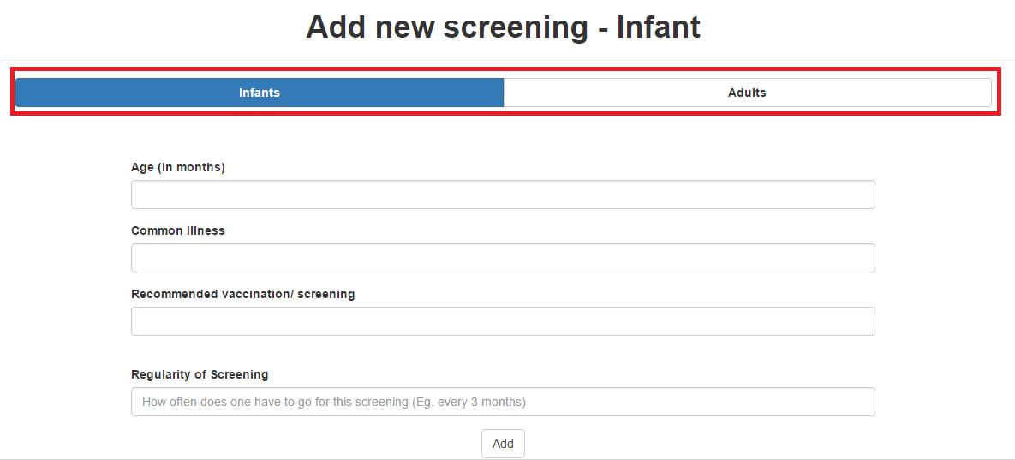
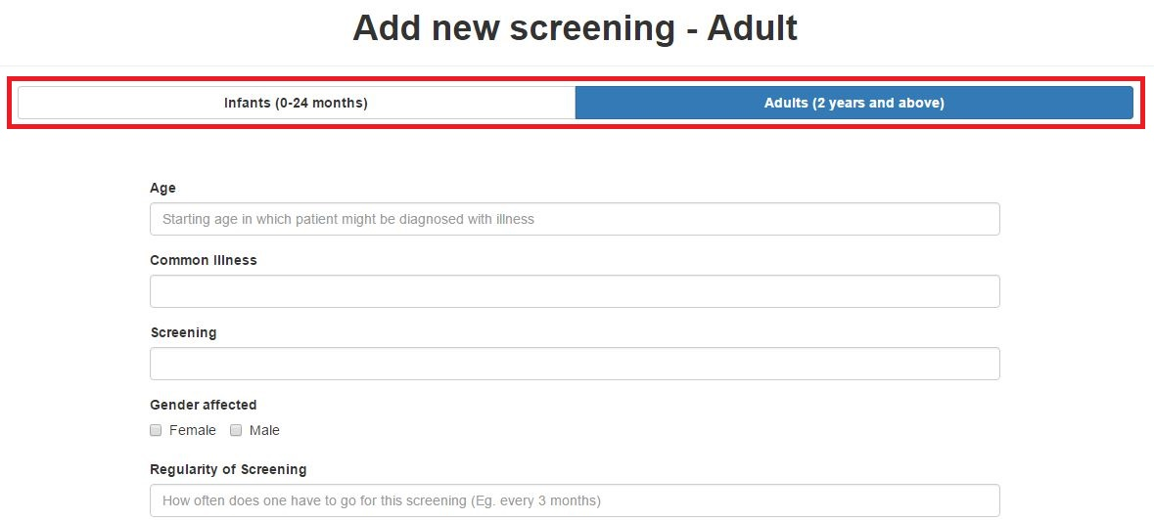
QUALITY ASSURANCE
USER TESTING 2
FEEDBACK:
Header of Screening form is not specific

Slide 32
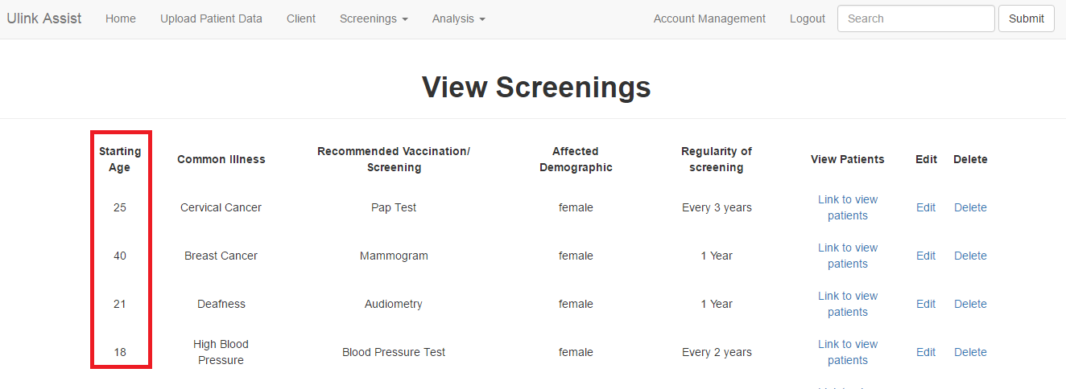
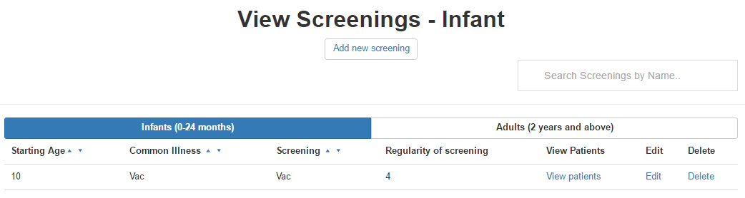
QUALITY ASSURANCE
USER TESTING 2
FEEDBACK:
Infants and Adults screenings should have different views
To prevent confusion in age (months, years)

Slide 33
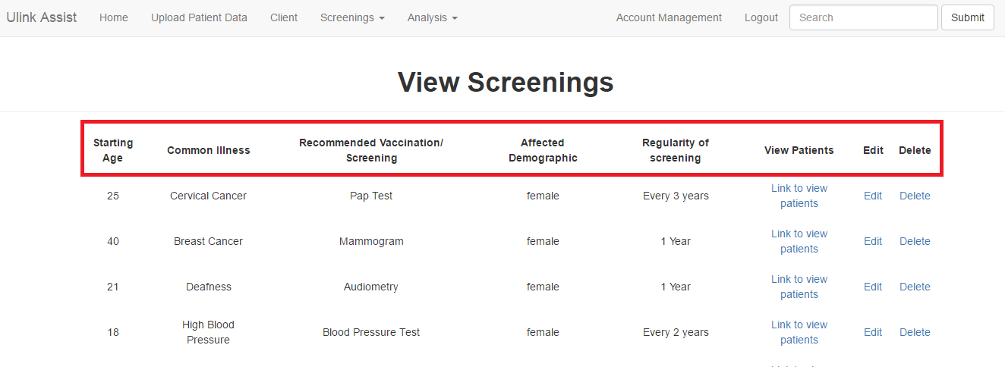
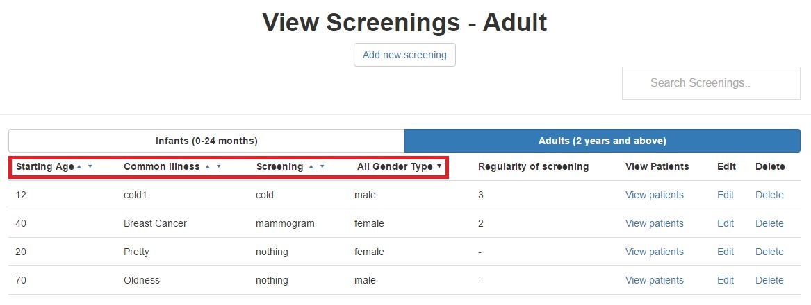
QUALITY ASSURANCE
USER TESTING 2
FEEDBACK:
Difficult to search for particular client/ screenings
Search & sort features allow easier search

Slide 34
QUALITY ASSURANCE
USER TESTING 3
PURPOSE
DETAILS
SCOPE
Gather UI feedback & detect usability issues
Measure time taken for each task
Participant: 6 Ulink employees
(Management, Medical, Visa, Marketing, Accounts)
Date: 13 February 2017
Time: 4.30pm
Venue: Ulink Assist Pte Ltd
Data Management
Dashboard Module
Reports Module
(KPI, Ranking, Gender-Age)
Screenings
Email Notification
Text Editor
Dashboard & Reports
Visual graphs provides better understanding
User interface
Straightforward & user-friendly

Slide 35
QUALITY ASSURANCE
USER TESTING 3 PROCEDURE
Login
Data Management
Reports -KPI
Reports - Ranking
Gender and Age
Screening
Dashboard
Email Recommended Screenings

Slide 36
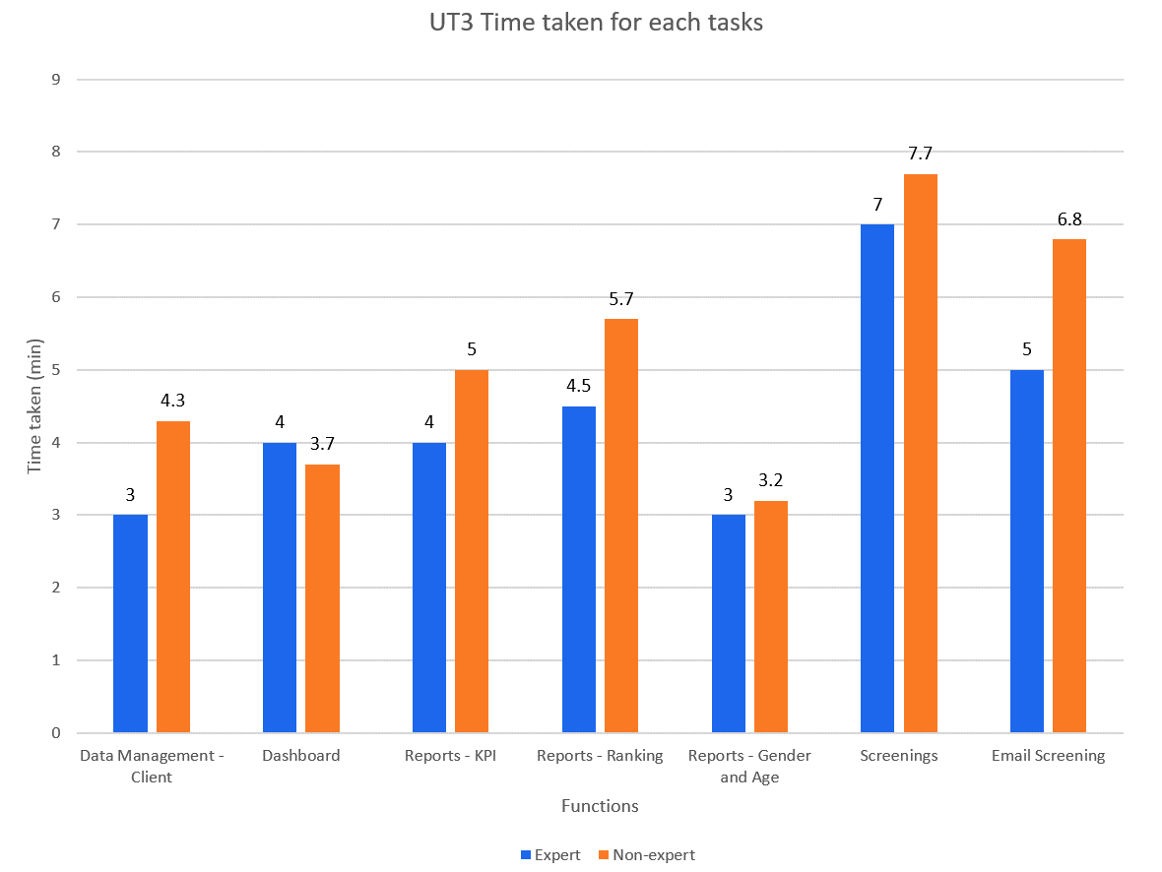
QUALITY ASSURANCE
UT 3 RESULTS
Non–experts should take not more than 150% of expert’s time taken

Slide 37
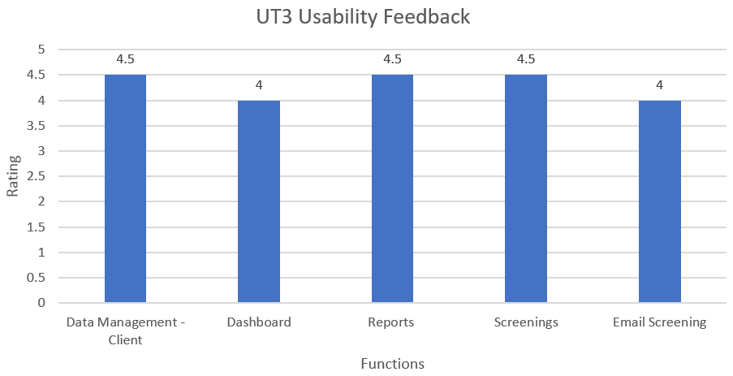
QUALITY ASSURANCE
UT 3 FEEDBACK
Very Easy
Very Difficult

Slide 38
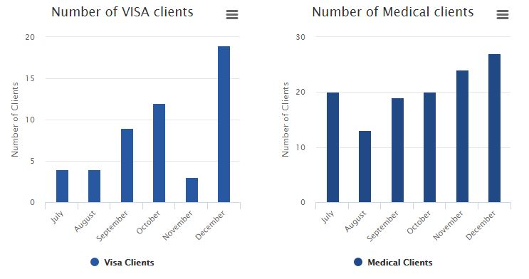
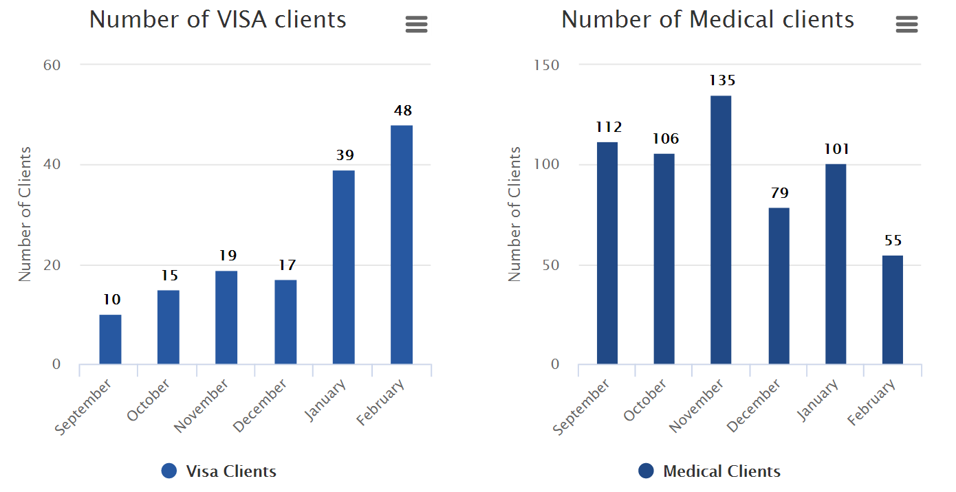
QUALITY ASSURANCE
UT 3 FEEDBACK
FEEDBACK:
Adding of data labels

Slide 39
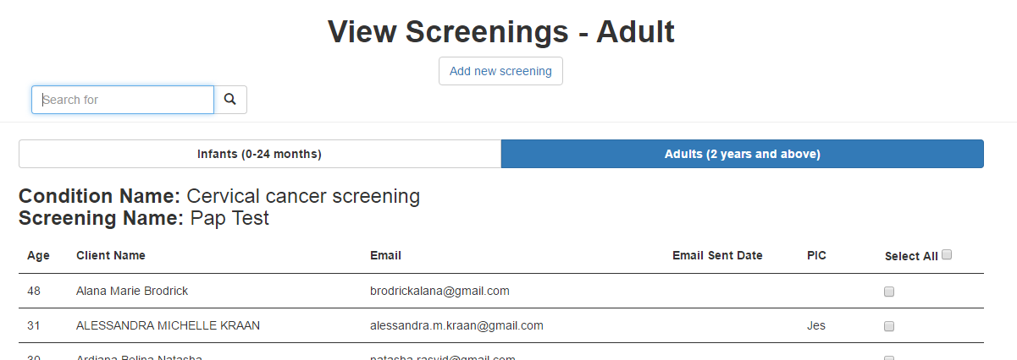
QUALITY ASSURANCE
UT 3 FEEDBACK
FEEDBACK:
Select All Button
‘PIC’ column
‘Email Sent’ column (Last sent date)

Slide 40
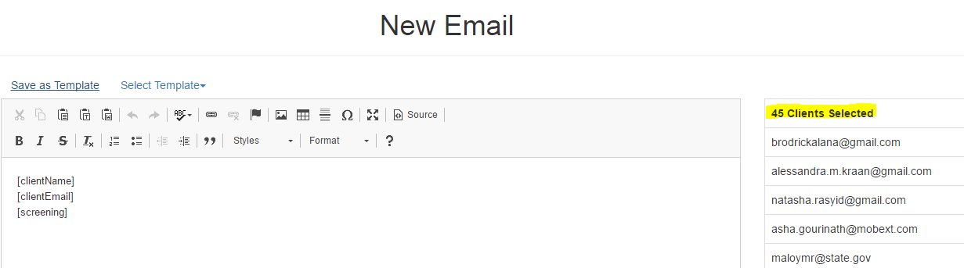
QUALITY ASSURANCE
UT 3 FEEDBACK
FEEDBACK:
Number of clients selected

Slide 41
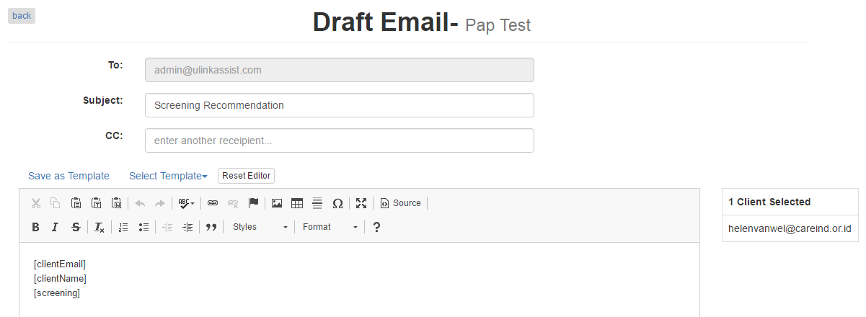
QUALITY ASSURANCE
UT 3 FEEDBACK
FEEDBACK:
Specify recipients

Slide 42
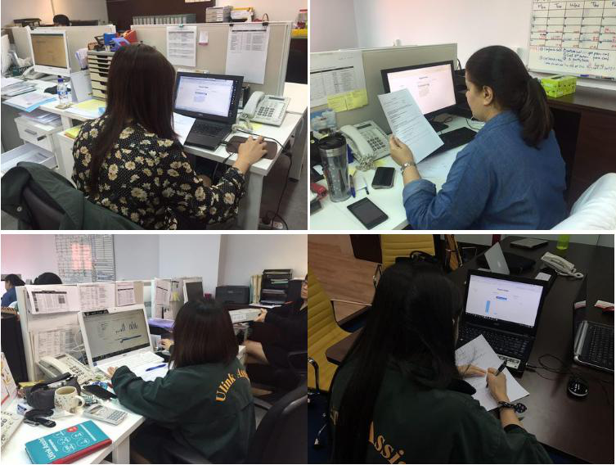
QUALITY ASSURANCE
USER TESTING 4
Email templates save time
PURPOSE
DETAILS
SCOPE
Gather UI feedback & detect usability issues
Participant: 8 Ulink employees
Date: 21 March 2017
Time: 4.00pm
Index
Client
Email Recommendation
Export
Unsure of where to click for certain functions
Exported graphs should have data labels
Not very sure of Index (Point of Contact) function
Drop down calendar not intuitive
Client Page is very long/ takes very long to load

Slide 43
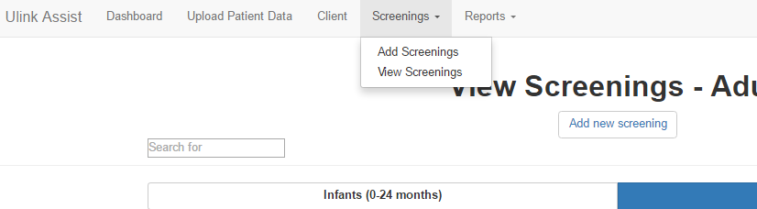
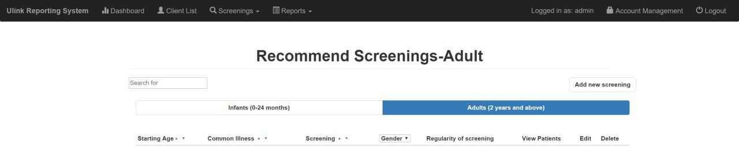
QUALITY ASSURANCE
UT 4 FEEDBACK
FEEDBACK:
Unsure of where to click for certain functions

Slide 44
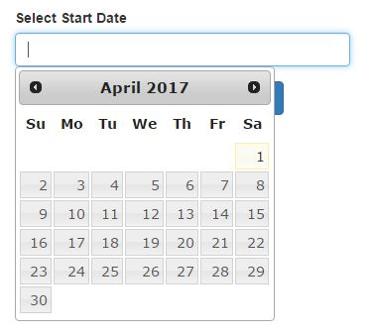
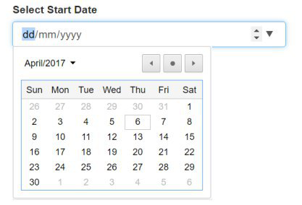
QUALITY ASSURANCE
UT 4 FEEDBACK
FEEDBACK:
Dropdown calendar not intuitive

Slide 45
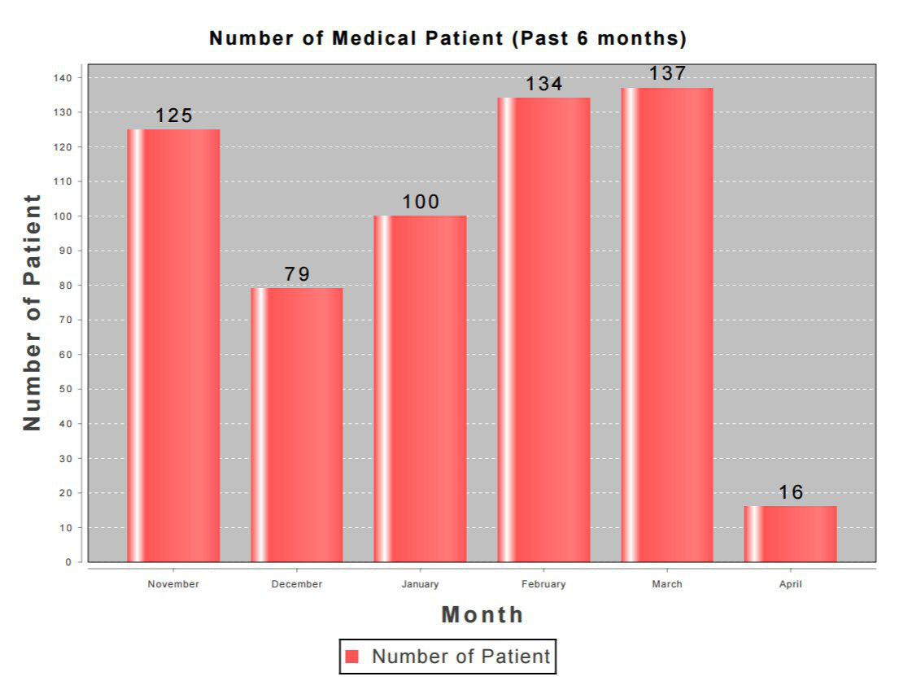
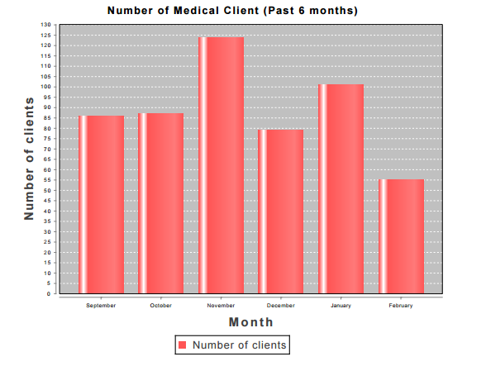
QUALITY ASSURANCE
UT 4 FEEDBACK
FEEDBACK:
Exported graph should have data labels

Slide 46
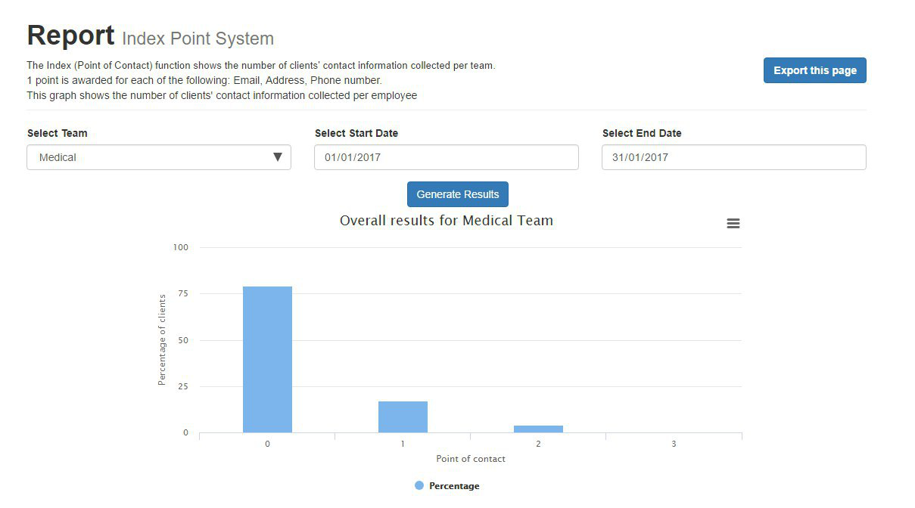
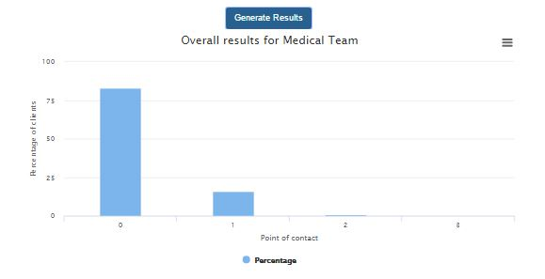
QUALITY ASSURANCE
UT 4 FEEDBACK
FEEDBACK:
Not very sure of Index (Points) function

Slide 47


QUALITY ASSURANCE
UT 4 FEEDBACK
FEEDBACK:
Client list is too long

Slide 48

QUALITY ASSURANCE
UT 4 FEEDBACK
Very Easy
4.5
4
4
3.5
Very Difficult

Slide 49

QUALITY ASSURANCE
UT 4 FEEDBACK
Good
4.5
4.5
4.0
Poor

Slide 50

QUALITY ASSURANCE
USER TESTING TAKEAWAYS
Gather perspective & opinions of different users
Continuously work on improving the functions

Slide 51

QUALITY ASSURANCE
BUG METRIC

Slide 52

QUALITY ASSURANCE
Screenings – unable to edit
Delete button removes data for both genders
BUG METRIC
Reports – Incorrect values generated
UI – Date picker, Filters
2
Client profile does not display as expected
Information displayed is wrong
Text Editor – special characters
1
1
1
1
2
2
1
2
12
1
2
1
1
1
9
1
7
8
4
5
6
4
5
5
3

Slide 53

PROJECT MANAGEMENT

Slide 54
PROJECT MANAGEMENT
PROGRESS
14
4
100%
ITERATIONS
USER TESTINGS
COMPLETION

Slide 55
PROJECT MANAGEMENT
STAKEHOLDER MANAGEMENT
Supervisor: Professor Steven Hoi
Bi-weekly meetings
Update project progress
Past Iteration & upcoming iteration
Obtain feedback on project
Gather suggestions

Slide 56
PROJECT MANAGEMENT
STAKEHOLDER MANAGEMENT
Sponsor: Ms Linda Siow
Bi-weekly meetings
Skype & emails
Update project progress
User Testing
Clarify user requirements
Gather feedback on prototype

Slide 57

PROJECT MANAGEMENT
STAKEHOLDER MANAGEMENT
Team
Weekly meetings
Changes in scope & timeline
Integration, testing & debugging sessions

Slide 58


PROJECT MANAGEMENT
ACCEPTANCE SCOPE

Slide 59

PROJECT MANAGEMENT
MIDTERM SCOPE

Slide 60


PROJECT MANAGEMENT
FINAL SCOPE

Slide 61

PROJECT MANAGEMENT
PLANNED SCHEDULE

Slide 62

PROJECT MANAGEMENT
MIDTERM SCHEDULE

Slide 63

PROJECT MANAGEMENT
FINAL SCHEDULE

Slide 64

CHANGE MANAGEMENT

Slide 65


CHANGE MANAGEMENT
PROCESS

Slide 66
CHANGE MANAGEMENT
CHANGES
Added/Modified | Removed
Report – POC Index | Doctors
Database – take in additional fields from excel file | Tasks
CRUD Templates feature | Services
Screenings – follow up person | SMS Notification
Screenings – email sent column | Rules
Text editor allows selection of recipients | Invoices
Fetching live data from clients’ database (Zoho CRM) | Currency Conversion
Export client emails | Creating additional tabs/ modules

Slide 67

CHANGE MANAGEMENT
CHANGE LOG

Slide 68

CHANGE MANAGEMENT
CHANGE LOG

Slide 69

CHANGE MANAGEMENT
CHANGE LOG

Slide 70

PROJECT MANAGEMENT
TASK METRIC
Screenings – unable to edit
Delete button removes data for both genders
Preparation for midterms
Bug fixing after midterms
Reports – Incorrect values generated
UI – Date picker, Filters

Slide 71

PROJECT MANAGEMENT
Under-estimated hours for acceptance
Midterms Presentation
Bug fixing before midterms
More hours required for bug fixing

Slide 72


PROJECT MANAGEMENT
RISK MANAGEMENT
TECHNICAL RISK
Unfamiliar with coding language
E,g. Javascript, JQuery
More experienced developer to share knowledge
Developers to research & learn technologies
Assistant developer to help with complex tasks

Slide 73
PROJECT MANAGEMENT
RISK MANAGEMENT
PROJECT MANAGEMENT RISK
Allocation of too much/ little time for development of functions
Buffer days before submission
Allocate more time for more complex tasks

Slide 74
PROJECT MANAGEMENT
RISK MANAGEMENT
CLIENT RISK
Change in client’s requirement
Meet & update client bi-weekly
Ensure that development is on par with client’s requirements
Present client prototype before development

Slide 75
X FACTOR

Slide 76
X FACTOR
FINAL
50% more targeted clients’ responses compared to non-targeted clients’
Ulink Reporting System fetches live data from Zoho CRM

Slide 77
X FACTOR
FINAL
Sent 100 screening recommendation emails
(50 targeted, 50 non-targeted)
50% more targeted clients’ responses compared to non-targeted clients’
Results
Targeted Responses: 21
Non-Targeted Reponses: 5

Slide 78

X FACTOR
Clients’ responses (via email, phone calls)

Slide 79

X FACTOR
At least 50% of clients’ responses (via email, phone calls)
Clients’ responses (via email, phone calls)

Slide 80

X FACTOR
Clients’ responses (via email, phone calls)

Slide 81
CLIENT FEEDBACK
ON SYSTEM
ON TEAM
Value-added functions for our team to track performance
Strengthen follow-up with our patients
Increase client engagements
Responsive and efficient
Easy to work with

Slide 82
FUTURE PLANS/ HANDOVER
13
Source codes
Database with current data
Documentations
APRIL

Slide 83

REFLECTIONS

Slide 84





REFLECTIONS
Shu yan
I have learnt the importance gathering users’ feedback through user testing so that we can continue improving our system to suit our clients’ needs.
nicole
I have learnt to explore different designs of our user interface. Through this project, I have gain more knowledge on front end development.
Sean
I have learnt the importance of communicating with my team mates in order to ensure that everyone is working towards the right direction.
Kaixin
Nabilah BANU
I have learnt to be more receptive to feedback given by our clients. On top of that, I learned to be more attentive to details when designing the UI.
I have learnt the importance of managing clients’ expectations and understanding the strengths of my team.

Slide 85

THANK YOU

